Slide 1
Hazard Communication Training
WAC 296-901-14016

Slide 2
HAZCOM Program
Every workplace with the possibility of an employee exposure to hazardous chemicals is required to have a written Hazard Communication Program.
The program ensure the employees right to know about chemical hazards in the workplace.

Slide 3
Topics to cover:
What are hazardous chemicals?
How do hazardous chemicals affect the body?
Where are hazardous chemicals located?
Ways to detect hazardous chemicals
Measures to protect yourselves
Hazard communication plan overview

Slide 4
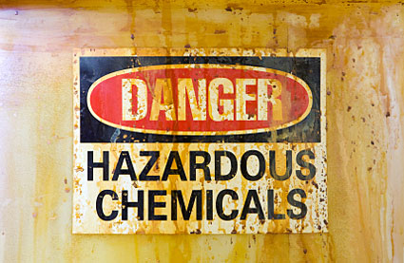
What are hazardous chemicals?
Hazardous chemicals are chemicals which are classified as a physical hazard or a health hazard
Most industrial chemicals can harm you at some level
The severity of damage is dependent upon how much gets into your body

Slide 5
How do hazardous chemicals affect the body?
It depends on….
How the chemical enters the body,
The physical form of the chemical,
The amount of chemical that enters the body

Slide 6

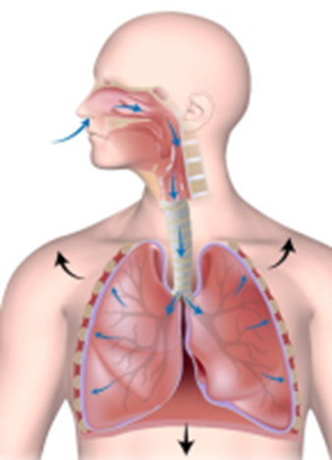

What are the ways chemicals can enter the body?
Ingestion
  Swallowing the chemicals
Inhalation
  Breathing the chemical into the lungs
Absorption
  Chemicals soak through the skin

Slide 7
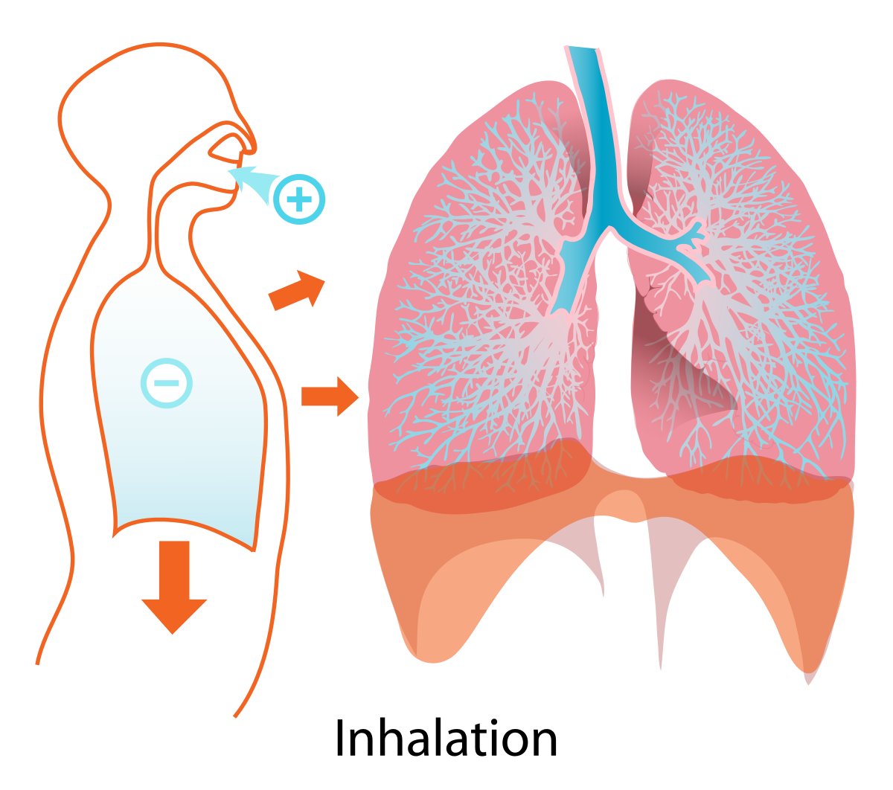
Which is the most common route of exposure?
Inhalation
  Most solid, and every liquid chemical, emits some measurable amount of a gaseous form of itself.
  This can be breathed into the lungs by
  anyone nearby.

Slide 8
Where are hazardous chemicals located?
Just about everyone has some kind of hazardous chemicals in their areas, whether it’s a spray disinfectant,

Slide 9
Health Hazards:
Acute Toxicity & Chronic Toxicity
Acute Toxicity Definition:
  Adverse effects of a substance that result from a single exposure, or multiple exposures in a short period of time (generally less than 24 hours)
When do effects occur?
  Usually within 14 days of exposure to the substance

Slide 10
Health Hazards:
Acute Toxicity & Chronic Toxicity
Chronic toxicity definition: Development of adverse effects as a result of long term, long duration exposure to a contaminant or other stressor.
Example of chronic toxicity exposure: Asbestos

Slide 11
Hazard Determination-Chemical Hazard Types
Physical Hazard
Health Hazard
Simple asphyxiation
Combustible dust
Pyrophoric gas
Other hazards not classified

Slide 12
Physical Hazard
Defined as a chemical that is classified as posing one of the following hazardous effects: explosive; flammable (gases, aerosols, liquids, solids); oxidizer (liquid, solid, gas); self-reactive; pyrophoric (liquid or solid); self-heating; organic peroxide; corrosive to metal; gas under pressure; or in contact with water emits flammable gas.

Slide 13
Health Hazard
A chemical which is classified as posing one of the following hazardous effects: acute toxicity (any route of exposure); skin corrosion or irritation; serious eye damage or eye irritation; respiratory or skin sensitization; germ cell mutagenicity; carcinogenicity; reproductive toxicity; specific target organ toxicity (single or repeated exposure); or aspiration hazard.

Slide 14
Simple Asphyxiation
A substance or mixture that displaces oxygen in the ambient atmosphere, and can thus cause oxygen deprivation in those who are exposed, leading to unconsciousness and death.

Slide 15
Methods used to detect the presence or release of hazardous chemical in the work area
Sampling/Measuring Devices
  Gas detectors, air monitors and samplers
Senses
  Vision: seeing an open container, leak or spill
  Smell: perhaps the most common method to detect a chemical

Slide 16
Hazard Communication Standard: Safety Data Sheets (SDS)
Safety data sheets
  Summarizes all of the available information available regarding the hazards of a chemical, as well as how to mitigate and respond to and potential exposures or release of the material

Slide 17
What information must be in the SDS?
Here are the 16 sections in the GHS SDS

Slide 18
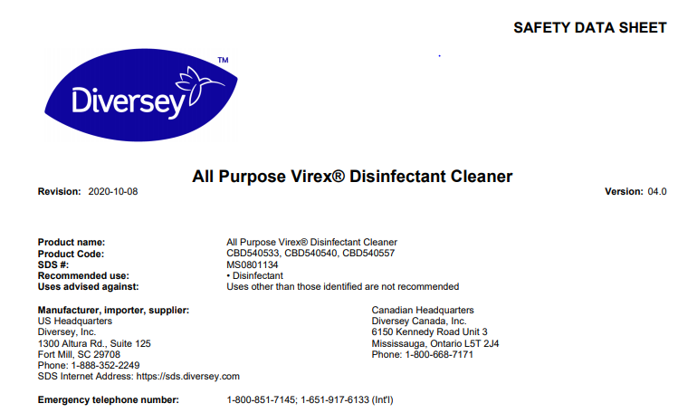
SDS Example:
1. Identification
Name:
Name, Address, and telephone number of manufacturer

Slide 19
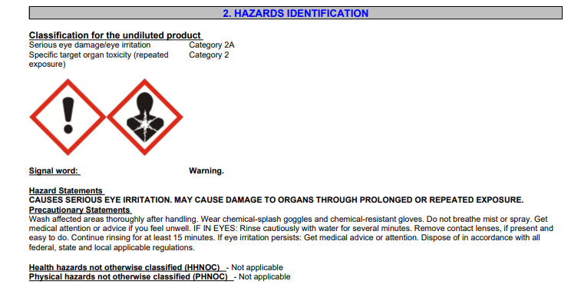
2. Hazards Identification
Pictograms
Signal Word
Hazard Statement
Precautionary Statement

Slide 20
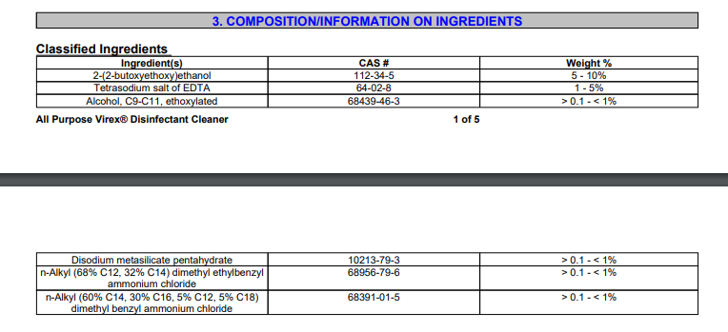
3. Composition/Information on Ingredients:

Slide 21
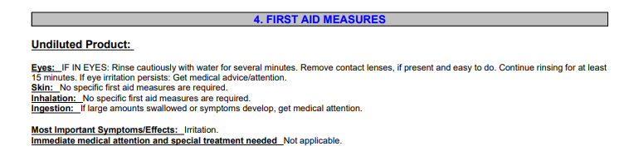
4. First Aid Measures

Slide 22
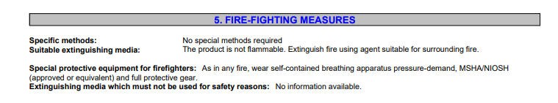
5. Fire-Fighting Measures

Slide 23

6. Accidental Release Measures

Slide 24
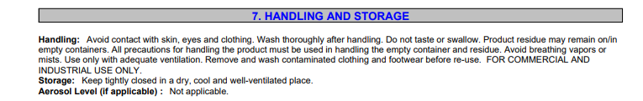
7. Handling and Storage

Slide 25
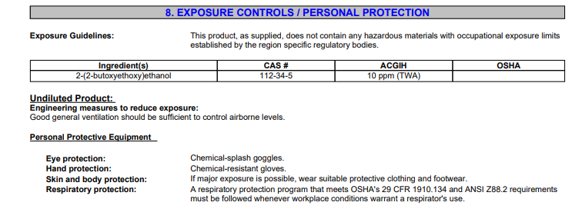
8. Exposure Controls/Personal Protection

Slide 26
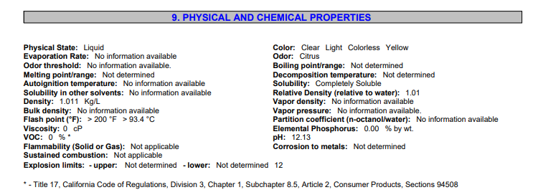
9. Physical and Chemical Properties

Slide 27
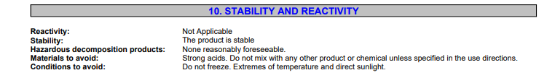
10. Stability and Reactivity

Slide 28
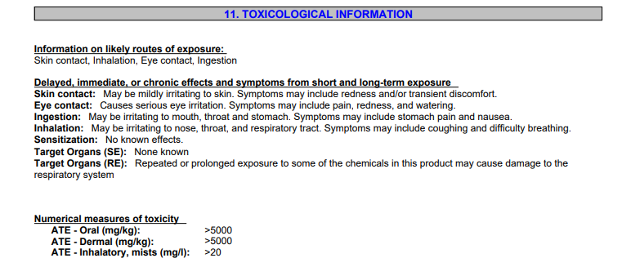
11. Toxicological Information

Slide 29
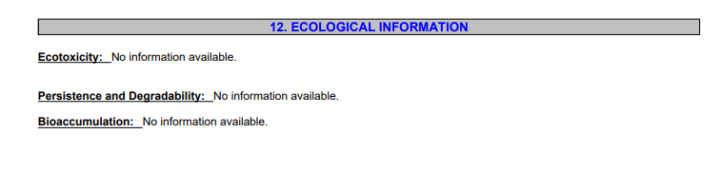
12. Ecological Information

Slide 30
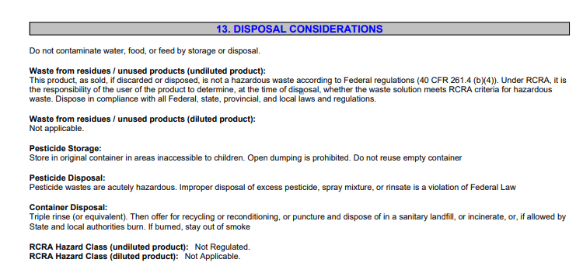
13. Disposal Considerations

Slide 31
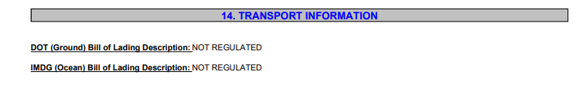
14. Transport Information

Slide 32
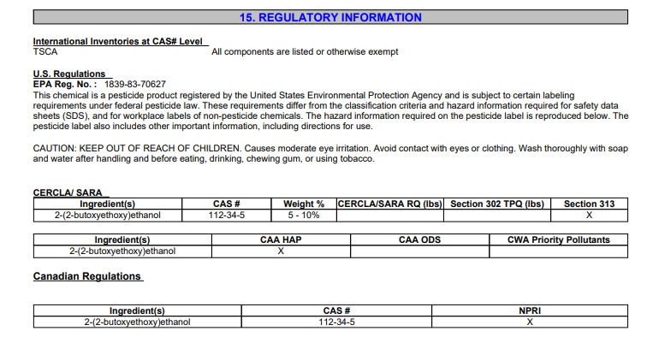
15. Regulatory Information

Slide 33
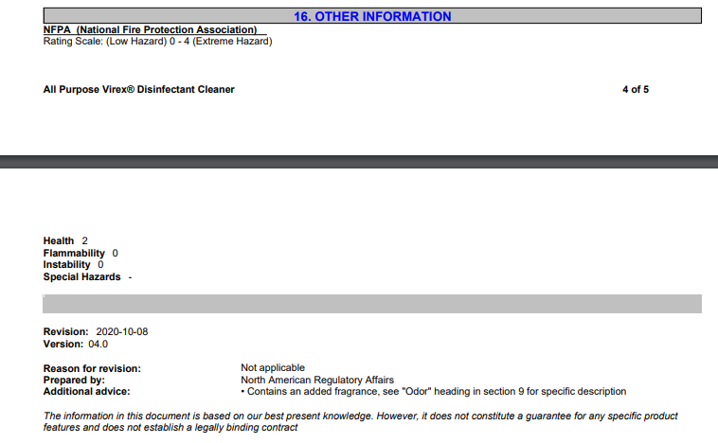
16. Other Information

Slide 34

How is SDS information stored?
SDSs are stored in our central database, utilizing our online inventory system, CHIMERA
They are also available at some locations around campus in hard copy form.

Slide 35
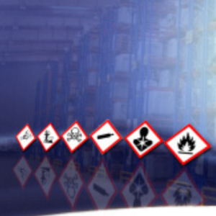
What is GHS?
GHS is an acronym for The Globally Harmonized System of Classification and Labeling of Chemicals.
  The GHS system makes all labeling and SDSs standardized and consistent throughout the world, no matter where the chemical is made.
  GHS label signal words are “Danger and Warning”
  Pictograms on GHS SDS or label are symbols that give you specific information about chemical hazards.

Slide 36

Pictograms
Each pictogram consists of a symbol on a white background, framed with a red border which represents a distinct hazard.

Slide 37

Health Hazard
Carcinogen
Mutagenicity
Reproductive Toxicity
Respiratory Sensitizer
Target Organ Toxicity
Aspiration Toxicity

Slide 38

Flame
Flammables
Pyrophorics
Self-Heating
Emits Flammable gas
Self-Reactives
Organic Peroxides

Slide 39

Exclamation Mark
Irritant (skin and eye)
Skin sensitizer
Acute toxicity (harmful)
Narcotic Effects
Respiratory Tract Irritant

Slide 40

Gas Cylinder
Gases Under Pressure

Slide 41

Corrosion
Skin corrosion/burns
Eye Damage
Corrosive to Metals

Slide 42

Exploding Bomb
Explosives
Self-Reactives
Organic Peroxides

Slide 43

Flame Over Circle
Oxidizers
These chemicals are not flammable themselves, but can cause a fire by increasing the amount of oxygen in the air. Will cause flammable chemicals to burn hotter and faster

Slide 44

Environment
Aquatic Toxicity
Chemicals that are toxic to fish or other organisms in water. A product is not a hazard to humans if this is the only pictogram.

Slide 45

Skull and Crossbones
Acute Toxicity (fatal or toxic)
Extremely poisonous. It will quickly make you very sick or even kill you if you inhale or swallow it, or get in on your skin.

Slide 46
Measures to protect yourself: Appropriate work practices, safety-related equipment, emergency procedures, personal protective equipment (PPE)
Fume hoods- Ventilated, enclosed work space designed to limit exposure to hazardous or toxic fumes, vapors, dusts.
Snorkels- Also known as local fume extractors, helps to capture fumes effectively.
Following the appropriate standard operating procedures (SOP’s), protocols, best practices, etc.
Examples of PPE: Gloves, respirators, goggles, etc. (PPE will vary depending on the hazards in your workplace.)

Slide 47

Large chemical releases or spills - what to do
Inform your supervisor of unusual chemical odors, spills, leaks or releases.
Immediately leave an area of a large spill or release since you could be overcome by the effects of toxic chemicals.
Don’t attempt cleanup unless you have been trained in emergency response.

Slide 48
Hazard Communication Program…
What Does It Entail?
What does the Hazard Communication Program Entail?
  Overview
  Definitions
  List of hazardous chemicals also known to be present
  Methods employer will use to inform employees of the hazards of non-routine tasks
  Container Labeling
  Employee Information and Training
  Non-Routine Tasks
  Multi-Employer Workplaces
  Contact Information

Slide 49
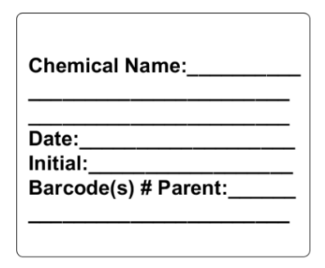
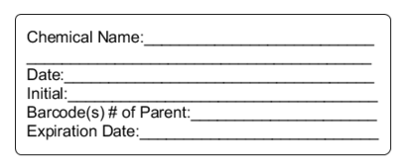
Secondary bottle labels
Each secondary container (e.g., bottles of buffer, aliquots of a chemical) must have a label plus any appropriate GHS pictogram(s) and/or signal word stickers. Labels (see below) are available in the biology and chemistry storerooms.
An example of an appropriately labeled secondary container is given on the next slide.

Slide 50
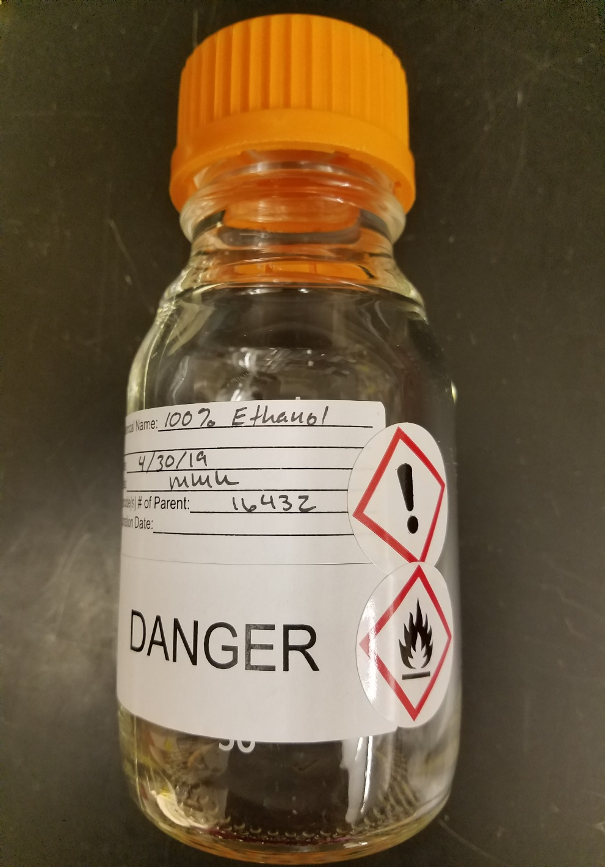
Example of Labeling a Secondary Container:

Slide 51
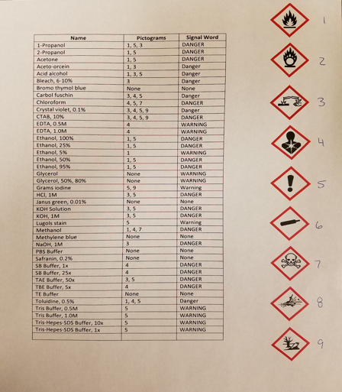
GHS pictograms for common substances:
Pictogram stickers are available in the biology and chemistry storerooms.
Copies of this form are available in the Biology Storeroom.
Check the Safety Data Sheet (SDS) for a chemical or compound to determine appropriate pictograms.

Slide 52
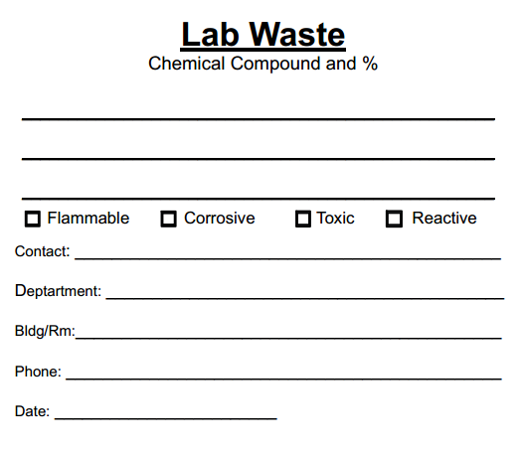
Labeling of waste containers
ALL chemical compounds/substances must be collected as waste. Waste containers are available in the biology and chemistry storerooms. All containers must be labeled, (an example of the biology label is below) to identify waste; list all compounds and their percentages. Deliver full waste containers to a storeroom.

Slide 53

This concludes our training…
Thank you for participating! If you are staff, faculty or student worker, please notify your supervisor that this training has been completed.

