Slide 1

Slips, Trips and Falls

Slide 2
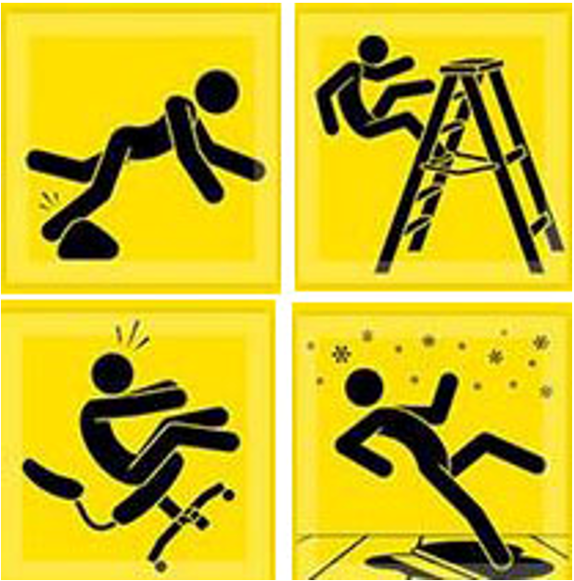
What this presentation covers
The costs of slips, trips and falls
Definitions
Causes of slips and trips
Factors increasing the risk of slips and trips
  Work environment
  Human factors
Note: This “slips, trips, and falls” module mainly cover injuries caused by slips and trips leading to falls at the same level.

Slide 3
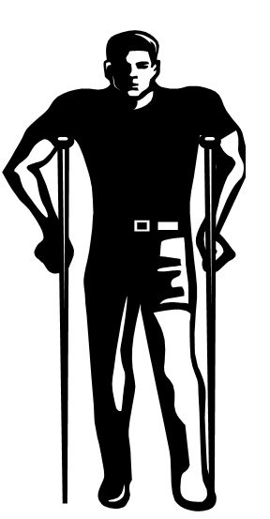
Slips, Trips, and Falls are Costly
Slips and trips can happen in any part of the workplace, inside or outdoors
Slips and trips often result in falls and more serious outcomes, including disabling injuries and even death. The costs to both worker and employer can be great:
To Worker:
pain
lost wages
temporary or permanent disability
reduced quality of life
depression
To Employer:
loss in productivity and business
Increased industrial insurance premiums
Costs associated with training replacement workers

Slide 4
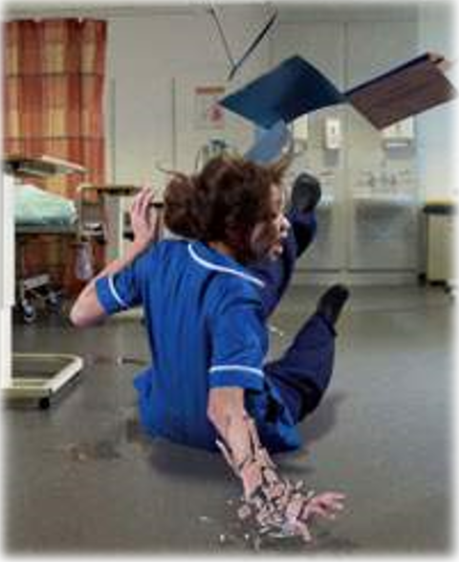
Slips, Trips and Fall Incidents Occur Frequently
According to the U.S. Department of Labor, slips, trips, and falls make up the majority of general industry accidents.
  15% of all accidental deaths (≈12,00/year), second leading cause behind motor vehicles
  One of the most frequent types of reports of reported injuries- about 25% of reported claims per fiscal year
  Over 17% of all disabling work injuries are the result of falls

Slide 5
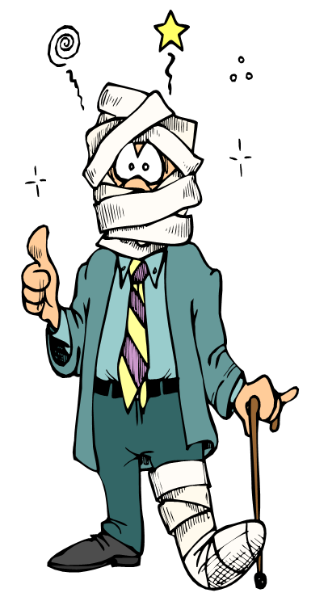
Injuries from Slips, Trips, and Falls
Common Types of Injuries:
Sprains, strains
Bruises, contusions
Fractures
Abrasions, cuts
Commonly affected body parts:
Knee, ankle, foot
Wrist, elbow
Back
Shoulder
Hip
head

Slide 6
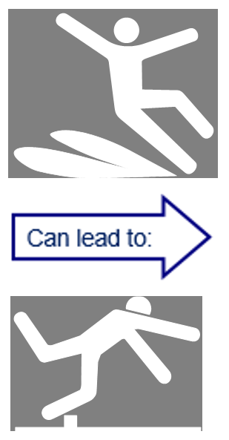
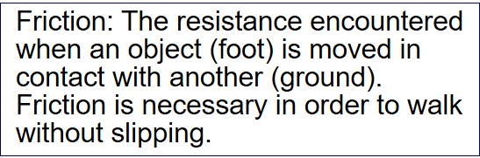

Definitions
Slip
When there is too little friction or traction between your feet (footwear) and the walking or working surface, and you lose your balance…
Fall
Occurs when you are too far off your center of balance.
Trip
When your foot (or lower leg) hits an object and your upper body continues moving, throwing you off balance.
When your step down unexpectedly to a lower surface (misstep) & lose your balance, e.g., stepping off a curb.

Slide 7


Definitions
Two types of falls:
Fall-at-the –same-level:
When you fall to the surface you are walking or standing on, or fall into or against objects at or above the surface.
Fall-to-lower-level:
When you fall to a level below the one which you are walking, working, or standing.
For example:
Step or stairs
Ladder
Platform
Loading dock
Truck bed
Skid-resistant coating on ramp. Note highlighted edges for better visibility to prevent walking off ramp and falling.
Slip-resistant strips on steps

Slide 8
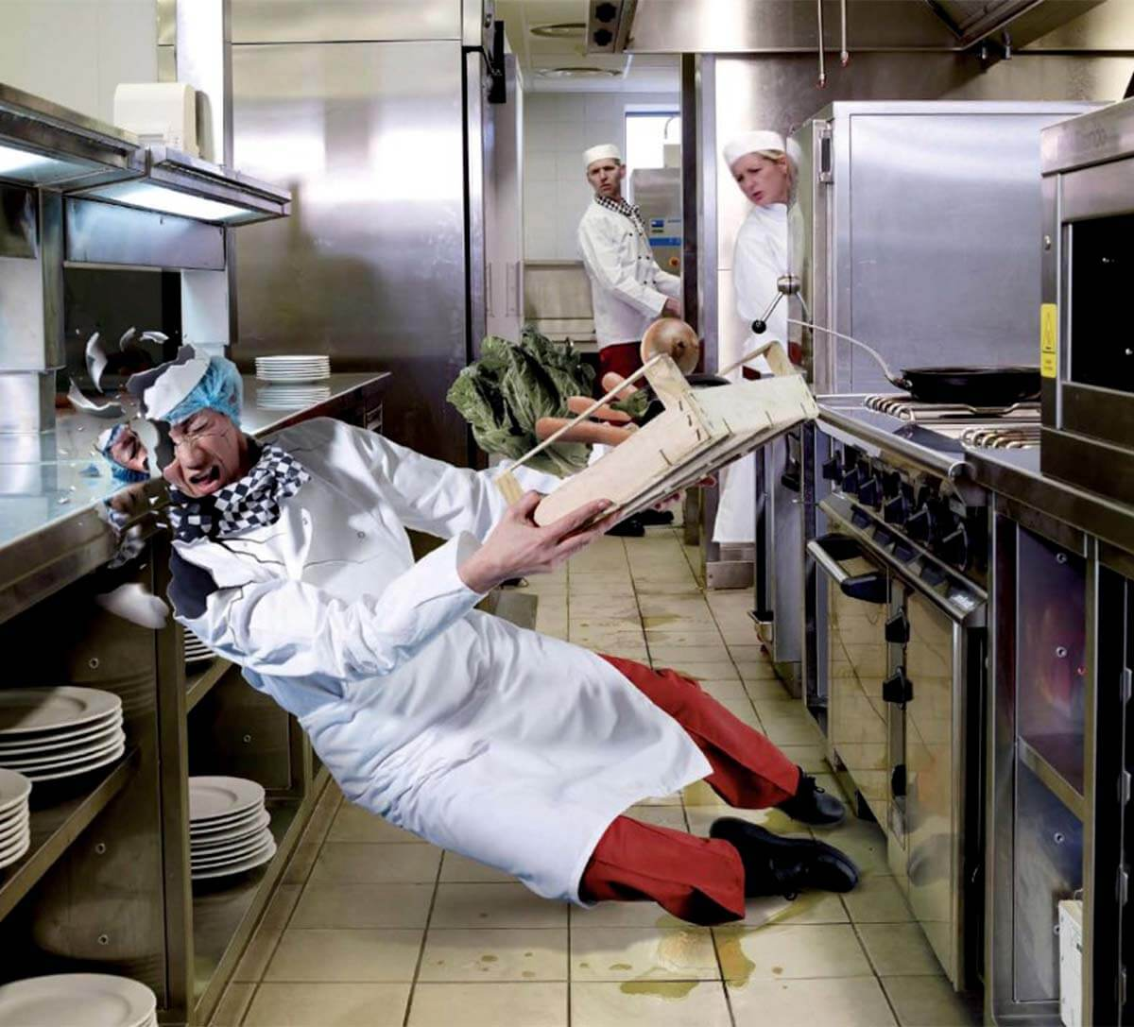
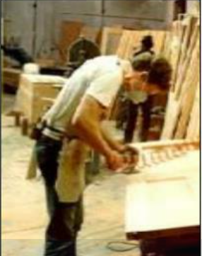
Causes of Slips
Some common causes of slips include the following:
“wet” contamination/spills on smooth floors or surfaces: water, fluids, mud, grease, oil, or food
“dry” contamination making surfaces slippery: dusts, powders, granules, wood, lint, or plastic wrapping

Slide 9
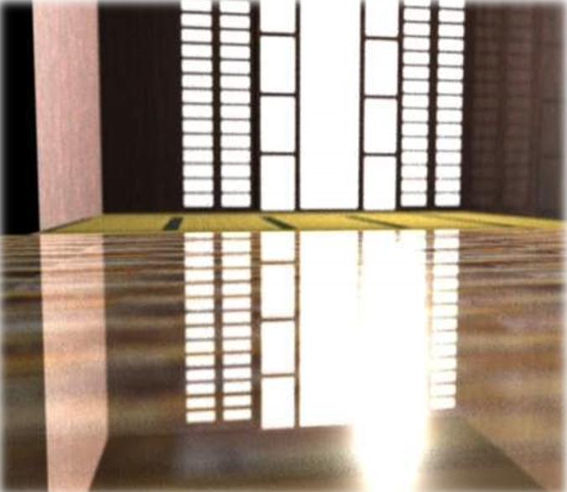
Causes of Slips
Highly polished floors, such as marble, terrazzo, or ceramic tile (can be extremely slippery even when dry)
Freshly waxed surfaces
Transitioning from one floor type to another (carpet to smooth surface flooring)
Transition from one type of flooring to another with less traction may cause a slip if one does not adjust for the change

Slide 10
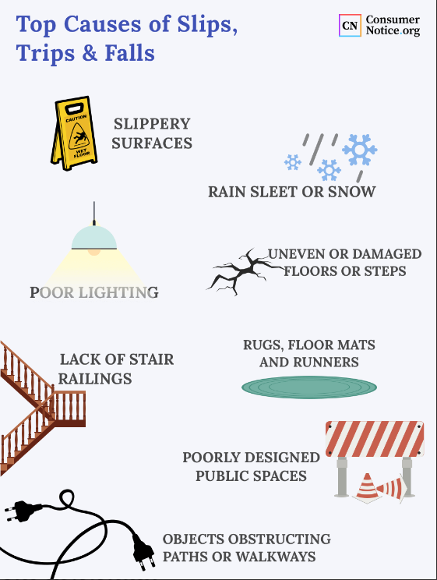
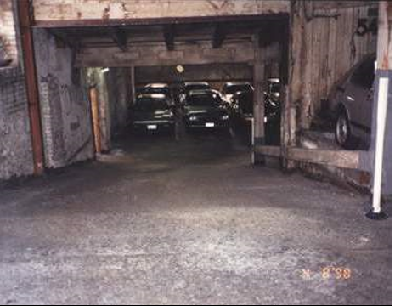
Causes of Slips
Sloped walking surfaces
Loose, unanchored rugs or mats
Loose floorboards or tiles that can shift
Shoes with wet, muddy, greasy, or oily soles

Slide 11
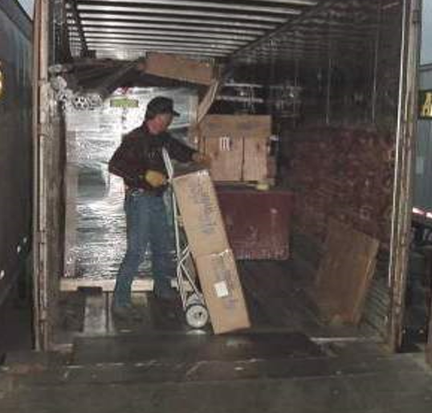
Causes of Slips
Ramps and gang planks without skid/slip-resistant surfaces
Metal surfaces, such as dock boards and dock plates, platforms, construction plates or covers on sidewalks and roads.
Metal has a lower force or friction/traction and can be more slippery than many other materials. Metal surfaces can become smooth and slippery with wear, and are extremely slick when wet, muddy, or greasy.

Slide 12
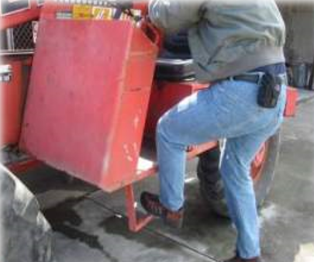
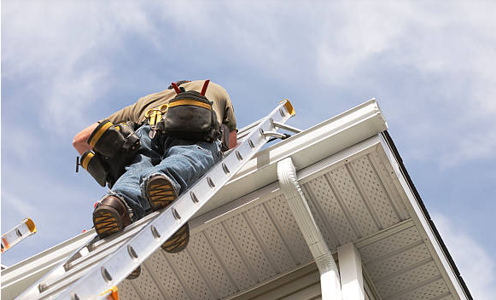
Causes of Slips
Mounting and dismounting trucks, tractors, heavy equipment or machinery
Getting on and off truck trailers & truck beds
Climbing up and down ladders
Metal rungs, steps, footholds, treads, running boards, platforms, on equipment and ladders become even slicker when worn smooth & contaminated with water, mud, oil, grease, dirt, and debris

Slide 13
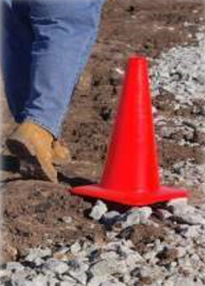

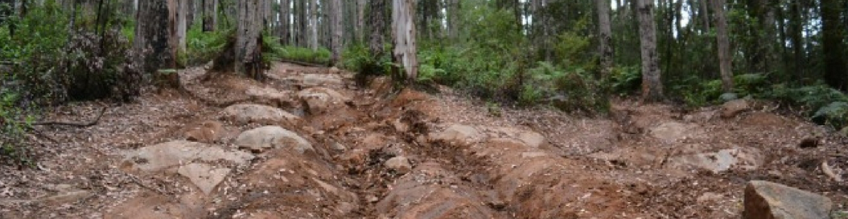
Causes of Slips
Loose irregular surfaces, such as gravel
Sloped or uneven terrain, sidewalks
Muddy terrain
Weather hazards: rain, sleet, ice, snow, hail or frost
Leaves, pine needles, or plant debris (especially if wet)

Slide 14
Human factors increasing the risk of slips and trips
Physical Condition
Health & physical condition can impair a person’s vision, judgement, and balance
Eyesight, visual perception
Age
Physical state, fatigue
Stress, illness
Medications, alcohol, drugs

Slide 15
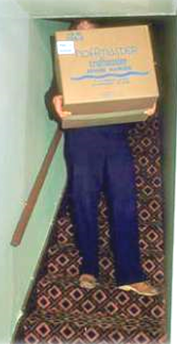
Human factors increasing the risk of slips and trips
Human Behavior
Behaviors-actions you choose and control- can contribute to a slip, trip, and fall injury if you practice careless work habits.
Carrying or moving oversized objects, or too many objects, that may:
Obstruct your view
Impair your balance
Prevent you from holding onto handrails

Slide 16
Human factors increasing the risk of slips and trips
Inattentive walking, distractions (using cell phones, talking and not watching where you’re going, etc.)
Taking shortcuts; not using walkways or designated cleared pathways
Being in a hurry, rushing around; moving too fast for safe practices in work environment
Poor housekeeping ( allowing clutter to accumulate or not maintaining clean dry floors)
Not using signs when slip or trip hazards exist
Footwear not suitable for the environment (reduced traction)

Slide 17

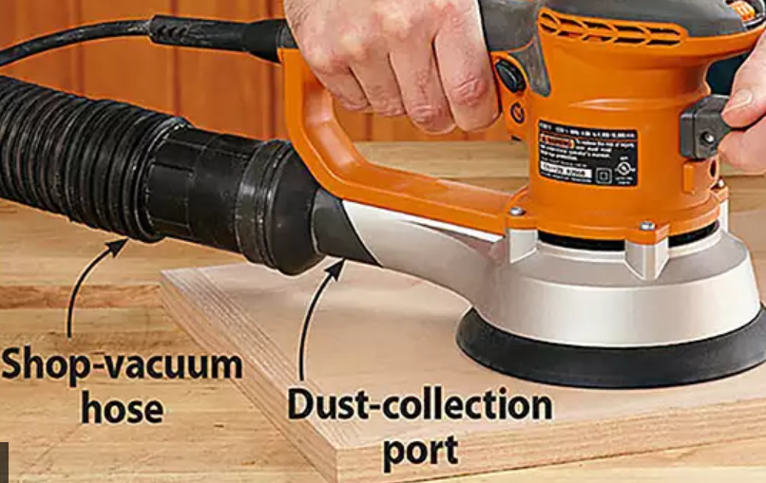
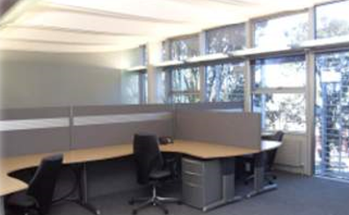
Ways to Prevent slips, trips, and falls
Contain work processes to prevent discharge, splatter, or spillage of liquids, oils, particles, dusts, etc. onto floor (use drip trays)
Have adequate ventilation to keep oil, steam condensation, water and grease off floor
Provide adequate lighting to keep work areas, aisles, and paths of travel well lit

Slide 18
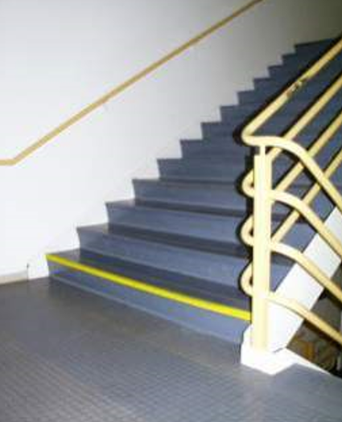
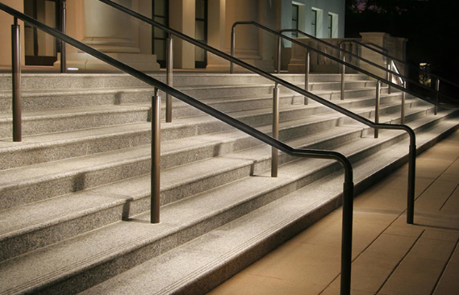
Ways to Prevent slips, trips, and falls
Mark/highlight step edges and transition areas (changes in elevations). Use anti-skid paint.
Confusing the bottoms step with the floor is a common occurrence when it’s not marked. No missing the last step here.
Step edges are highlighted for better visibility to prevent a misstep and fall down the stairs.
Make sure stairs have sufficient lighting and hand rails

Slide 19
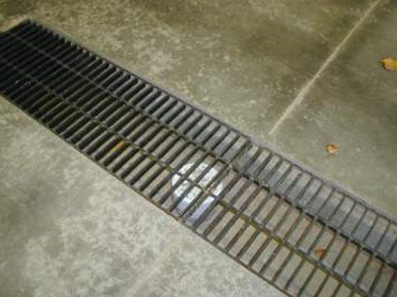
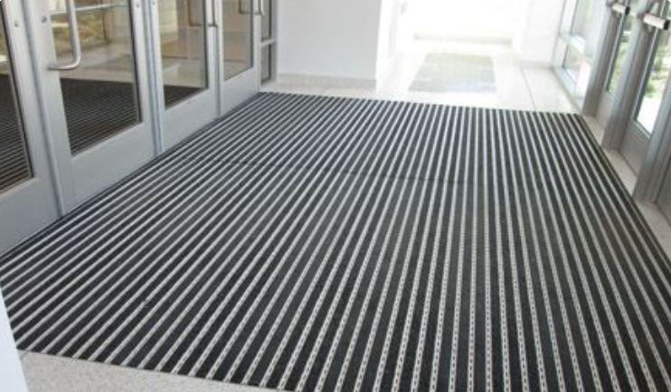
Ways to Prevent slips, trips, and falls
Provide effective floor draining where water on the floor will occur
Install slip-resistant floors in high risk areas (entrances, kitchens)

Slide 20
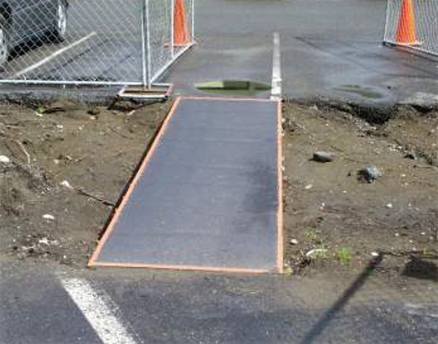
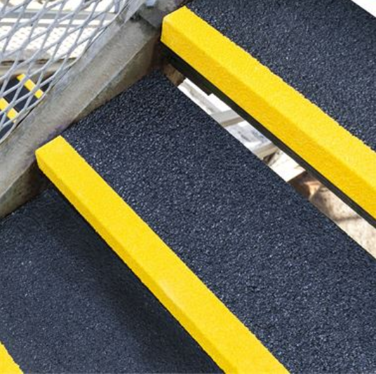
Ways to Prevent slips, trips, and falls
Apply slip- resistant coating or strips
Skid-resistant coating on ramp. Note highlighted edges for better visibility to prevent walking off ramp and falling.
Slip-resistant strips on steps

Slide 21
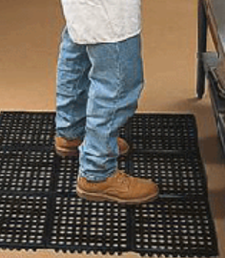
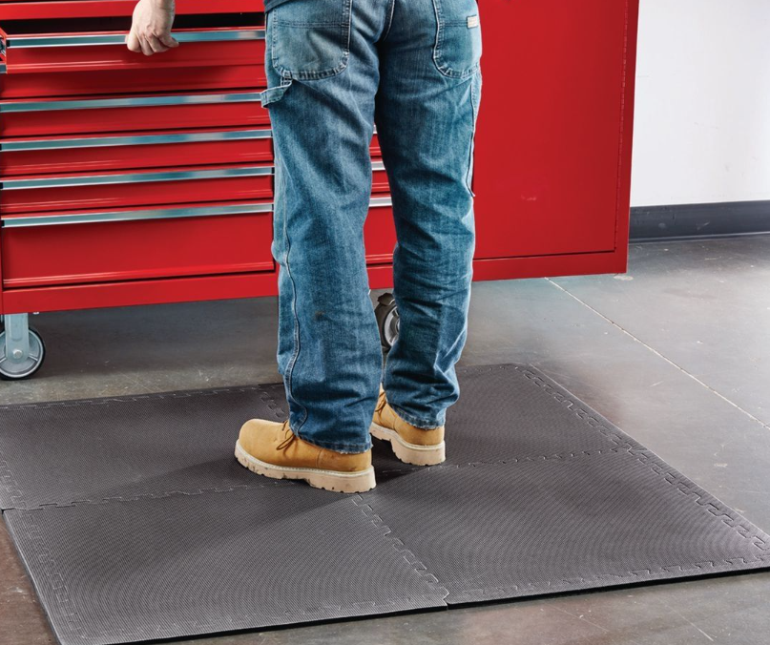
Ways to Prevent slips, trips, and falls
Use Slip/Skid-resistant matting
Skid-resistant, anti-fatigue mats in kitchen and food preparation areas. Worker is also wearing slip-resistant shoes

Slide 22
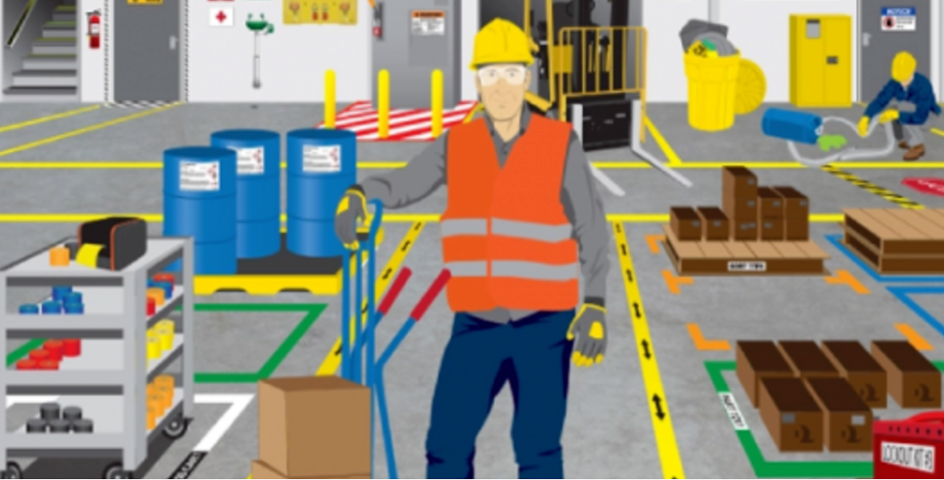
Maintaining Work Areas: Housekeeping
Keep walkways, aisles, and stairs clear of materials, equipment, and other hazards
Cover or secure (or suspend overhead on construction sites) cables, cords, wires, and hoses away from walkways and other paths of travel
Make sure rugs or mats are flat and not bunched up
Pathway is clearly marked and free of obstructions

Slide 23
Safe Walking Practices
Check that your pathway is clear and your view is not blocked before lifting anything
When going to another floor/level, take the elevator if you are carrying a load requiring both hands
Report any missing or broken stair rails and slippery or damaged flooring, loose or deteriorating carpeting. Repair or report floor problems, such as missing tiles.
Walk carefully and slowly when you transition from one type of walking surface to another.
Take extra care when you come indoors with wet shoes or boots
Slow down and take small careful steps if the surface is uneven, cluttered, slippery or at an angle.
Wear stable shoes with non-slip soles
Hold onto railings or other stable objects

Slide 24
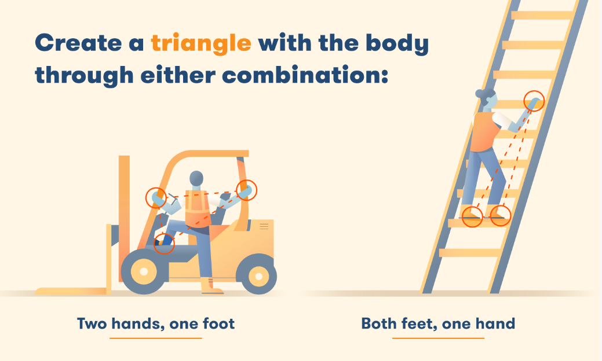
Mounting/Dismounting Equipment Safely
Clean footwear of mud, snow, ice, grease, or any other contamination
Make sure running board, tread, step, foothold, and platform of equipment are also clean and dry of any contamination
Always face equipment when mounting or dismounting
Maintain three-point contact at all times

Slide 25
Falling Properly
If you do fall, you can reduce the chance of serious injury if you:
Roll with the fall; don’t reach out. Let your body crumple and roll
Bend your elbows and knees and use your legs and arms to absorb the fall
Get medical attention after a fall to treat anything torn, sprained, or broken.

Slide 26
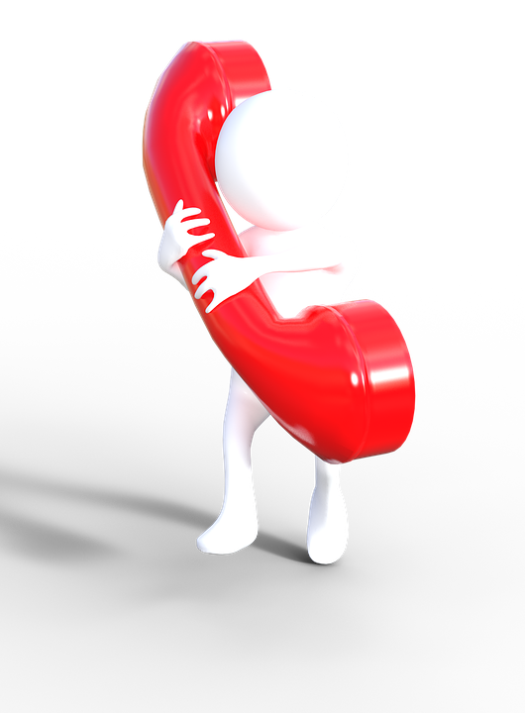
What if you come across a potential hazard?
Contact the Facilities Help Desk (253) 879-3713

Slide 27
Resources
National Floor Safety Institute
OSHA
NSC- Make fall safety a top priority
L&I Training
Once you have completed this training reach out to your supervisor, znavarrete@pugetsound.edu or mattjohnson@pugetsound.edu

